Slide 1



The Patterns
Cloud Native design, Domain Driven Design & Microservices
Notes:
Resting slide on screen before you begin presenting.

Slide 2
Agenda
The Monolith
Domain Driven Design
Cloud Native

Slide 3

The Monolith
Forces
Solution
Resulting Context
Notes:
Forces
Team of developers working on a project
New team members must be productive
Application must be easy to understand and modify
Scale up - scalability, availability and resiliency
Solution
Multi-module packaged in single WAR or even EAR
Single directory hierarchy
N-Tier Architecture
Layered Architecture
Resulting context
Complexity becomes the enemy
Overloaded web container
Continuous delivery becomes burdensome
Scale out
Technical debt
Domain specificity

Slide 4
“Anyone who has never made a mistake has never tried anything new.”
- Albert Einstein
Notes:
The object here is if you fail then fail fast
What is the methodology for designing a microservice?
How to break up a monolith?
What are the design patterns?

Slide 5

Domain Driven Design
Cloud Native Design
Notes:
Rise of the Jedi is the focus here, design patterns and architecture to move us away from the dark side

Slide 6
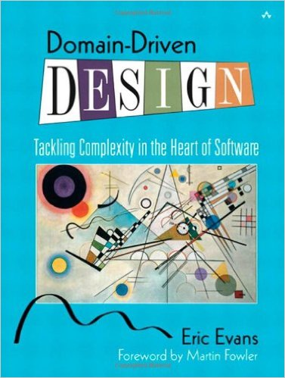
Domain Driven Design
An approach for designing software system that model the complexity of the real world
Kicked off in 2004 by Eric Evans
A practical microservice design methodology

Slide 7
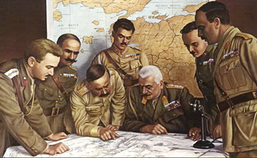
Strategic Domain Driven Design
Domain
Sub-Domain
Bounded Context
Ubiquitous Language
Context Map
Notes:
Picture from http://www.quikmaneuvers.com/principles_of_strategy.html need to check on license rights

Slide 8
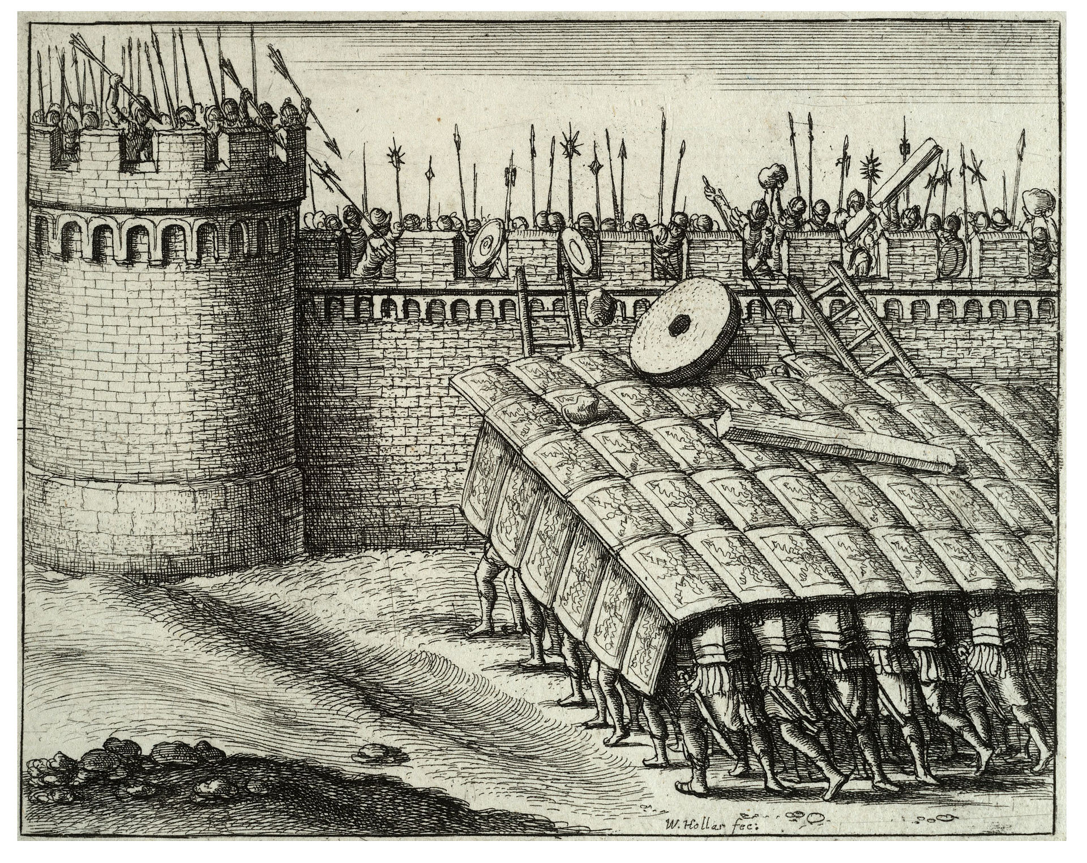
Tactical Domain Driven Design
Entities
Value Objects
Aggregates
Services
Modules
Factories
Repositories
Notes:
Public domain photo https://en.wikipedia.org/wiki/Testudo_formation#/media/File:Wenceslas_Hollar_-_A_testudo.jpg

Slide 9
Domain
Domain is always organization specific
Captures unique know how and way that an organization does business
Composed of sub-domains & bounded contexts

Slide 10
Sub-Domains
Core
Subdomain
Supporting
Subdomain
Generic
Subdomain
Build It Perfectly
Build It
Just enough
Buy It

Slide 11
Bounded Contexts
Banking Context
Security
Context
Account
Account
Account

Slide 12
Ubiquitous Language
Technical Jargon
Business Jargon

Slide 13
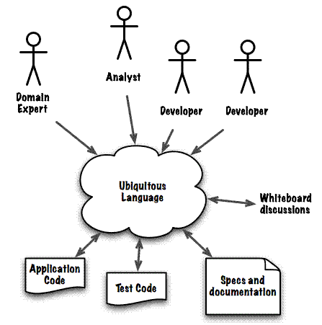
http://www.infoq.com/articles/ddd-contextmapping

Slide 14
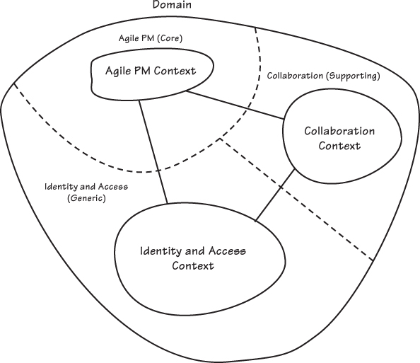
Solution
Figure 2.7 from Implementing Domain Driven Design

Slide 15
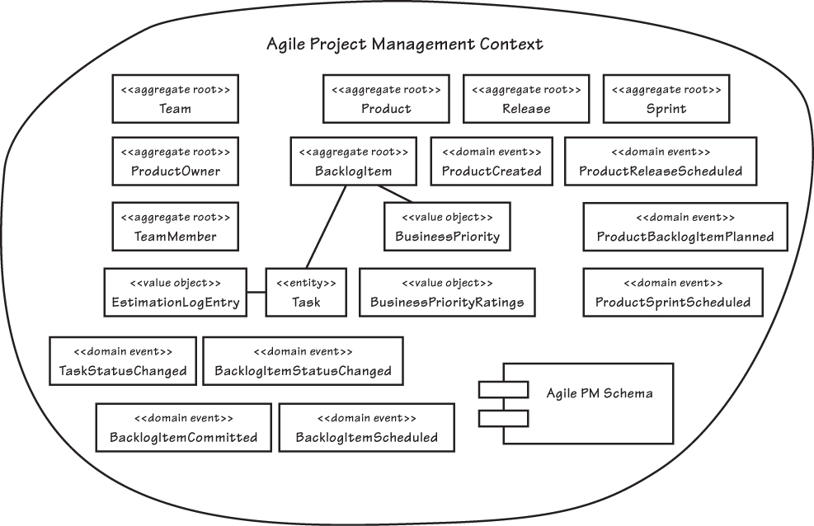
Example Bounded Context
Entities
Domain Event
Value Objects
Aggregates
Services
Modules
Factories
Repositories
Notes:
Figure 2.10 from Implementing Domain Driven Design

Slide 16
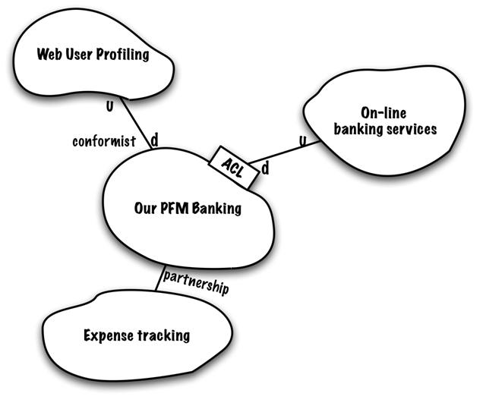
Context Maps
A map of the existing organization & integration relationship between different bounded contexts
Partnership
Shared kernel
Customer-supplier development
Conformist
Anti-corruption layer
Open host service
Published language
Big ball of mud

Slide 17
Partnership
Succeed or fail together promoting a close co-operation between teams working on the bounded contexts
Context
A
Context
B
partnership

Slide 18
Customer Supplier
Success of the supplier partially depends on the success of the customer
Context
A
Context
B
customer-supplier
D
U

Slide 19
Conformist
Upstream does not care about downstream
Context
A
Context
B
conformist
D
U

Slide 20
Anticorruption Layer
An isolation translation layer allowing downstream to work with upstream using downstream bounded context domain concepts
Context
A
Context
B
ACL
conformist
D
U

Slide 21
Open Host Service
An upstream protocol for accessing its services
Context
A
Context
B
ACL
conformist
OHS
D
U

Slide 22
Published Language
A common well documented language that facilities translation between different contexts
Context
A
Context
B
ACL
conformist
PL
D
U

Slide 23
Manifestations of DDD

Slide 24
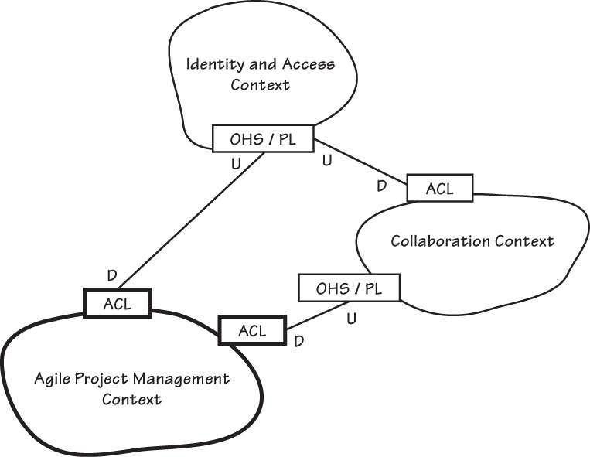
Context Mapping Example
Notes:
Figure 2.10 from Implementing Domain Driven Design

Slide 25
Domain Driven Design
Cloud Native Design
Notes:
Rise of the Jedi is the focus here, design patterns and architecture to move us away from the dark side

Slide 26
Cloud Native Design
Evaluate components for 12-factor compliance
Evaluate components and architecture for Cloud Native Design

Slide 27
Cloud Native Design
Evaluate components for 12-factor compliance
Evaluate components and architecture for Cloud Native Design
Standalone services
Common services

Slide 28
Evaluate for 12-Factor Compliance
no file based access to resources
run code on demand
coordinate cross service configurations
route public requests
read and write persistent data
add and remove resources
record internal and external events
isolate resources and failures
measure performance and health
detect and determine failure (plan & provoke failure)
recover failures
work tomorrow

Slide 29
Evaluate for the Cloud
Cloud Native
Micro-service architecture and principles
API first design
Cloud Resilient
Design for failure
Apps are unaffected by dependent service failure
Cloud Friendly
Twelve factor applications
Horizontally scalable
Cloud Ready
Proactive testing for failure
Cloud agnostic runtime implementation
Metrics and monitoring baked in
Leverage platform for HA
No file-system requirements or uses S3 API
Self-contained application
Platform managed ports and addressing
Consume off platform services using platform semantics

Slide 30
Let’s talk about SpringTrader

Slide 31
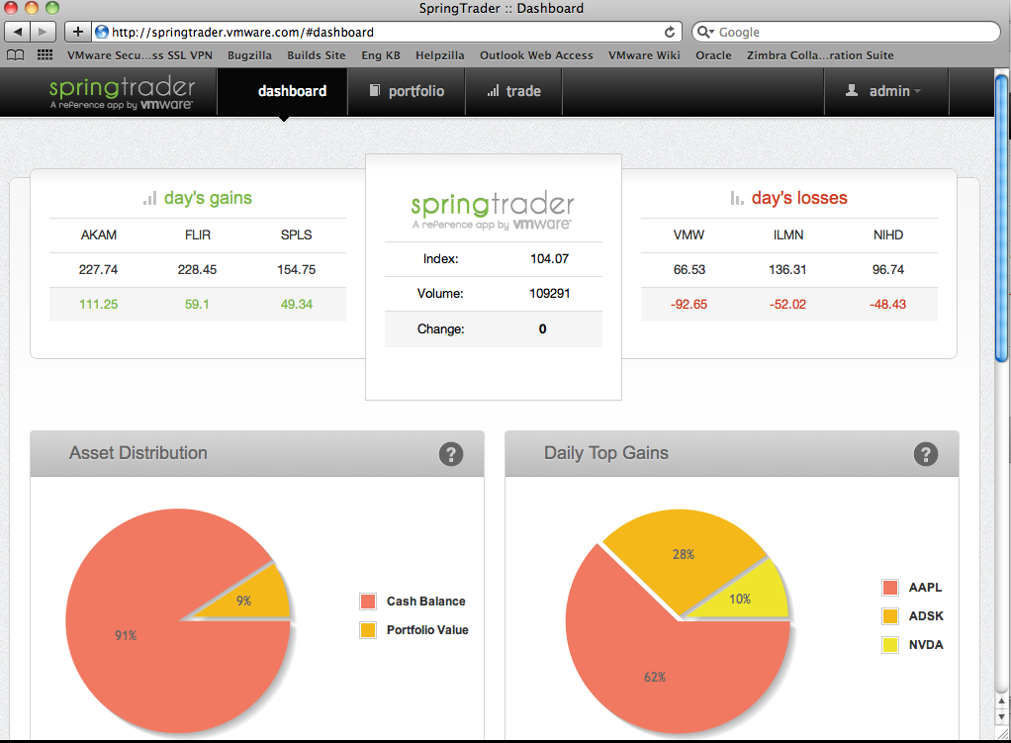

Slide 32
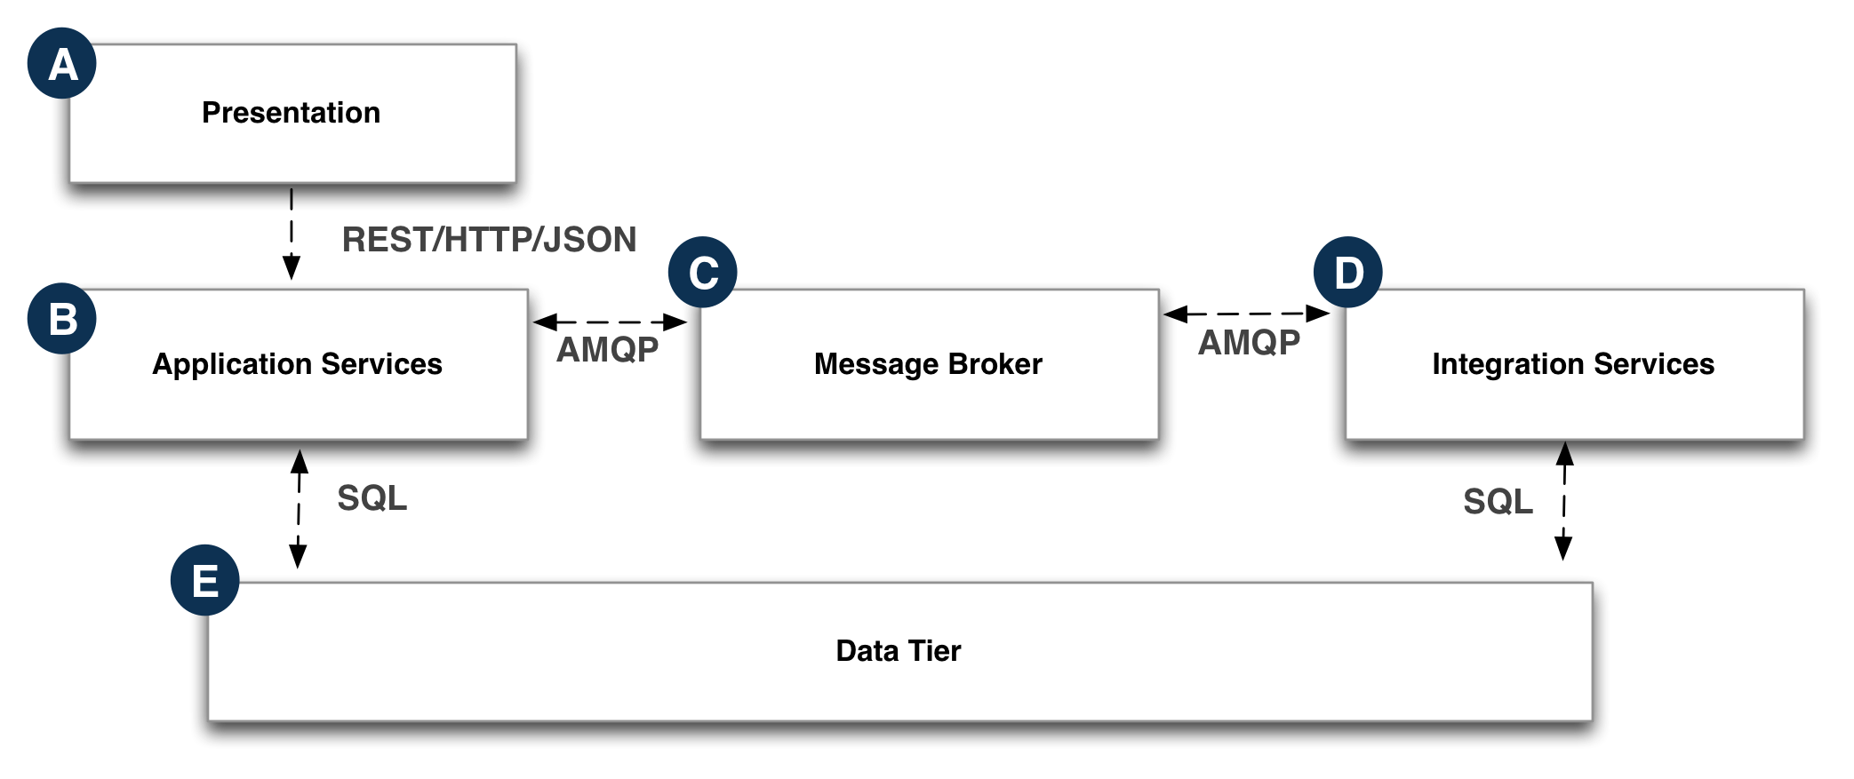

Slide 33
Use Case
if securities are subjected to randomized changes, as if by market forces – wouldn’t it be better to make use of real-time data?

Slide 34
Goals
Replace the existing simulated Quote data with real-time data
Minimize changes to existing code base
Make sure we have a working system when refactoring occurs

Slide 35
Introduce Microservice
Locate the code
Identify a service interface
Use the proxy pattern
Create an implementation of the interface
Point the monolith to the new service
Notes:
Locate the code that represents the functionality that will be refactored
Identify a service interface that will be the “go-to” for the rest of the monolith
Use the proxy pattern and modify existing code so that it exclusively funnels through this service interface
Create an implementation for the monolith to talk to our new microservice, and provide code to bridge any “impedance mismatch”
Point the monolith to the new service via the new implementation

Slide 36
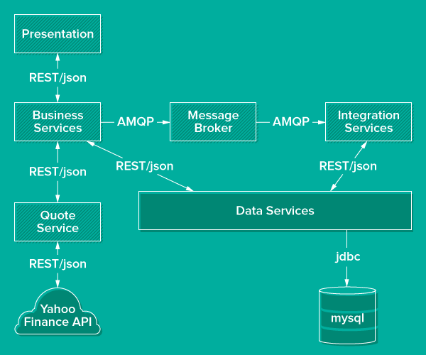

Slide 37
Service Availability
Provide a way to handle failures in remote services
Provide a way to locate and manage loosely coupled services
Make changes while minimizing changes to existing codebase
Make sure there is a working system, are there test to validate

Slide 38
Introduce
Config Server
Service Discovery
Circuit Breaker
Notes:
Service Discovery - we need a simple approach to enable locating microservices by name and at a known catalog endpoint. And use this dynamically at runtime
Circuit Breaker - if a service becomes unavailable, a “fallback method (to an alternative service with similar functionality) can be invoked instead. Normal operations is automatically restored once the failing service is available

Slide 39
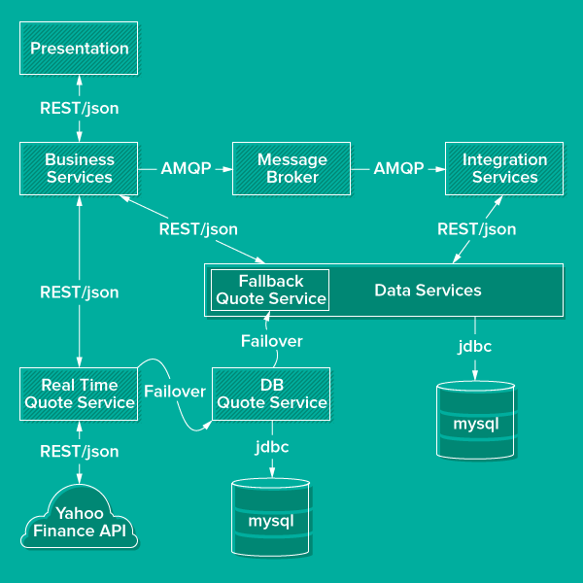

Slide 40
Decompose Further (remember domains)
Use the same technique used on QuoteService to “evaporate” the data modules
Notes:
Service Discovery - we need a simple approach to enable locating microservices by name and at a known catalog endpoint. And use this dynamically at runtime
Circuit Breaker - if a service becomes unavailable, a “fallback method (to an alternative service with similar functionality) can be invoked instead. Normal operations is automatically restored once the failing service is available

Slide 41
Approach
We have interwoven domain models
Domains can be difficult to untangle, but bounded context techniques can help
Quotes: external market events that happened outside the system
Accounts: users of the system, and their profiles
Orders: transactional events acted on by users
Notes:
Service Discovery - we need a simple approach to enable locating microservices by name and at a known catalog endpoint. And use this dynamically at runtime
Circuit Breaker - if a service becomes unavailable, a “fallback method (to an alternative service with similar functionality) can be invoked instead. Normal operations is automatically restored once the failing service is available

Slide 42
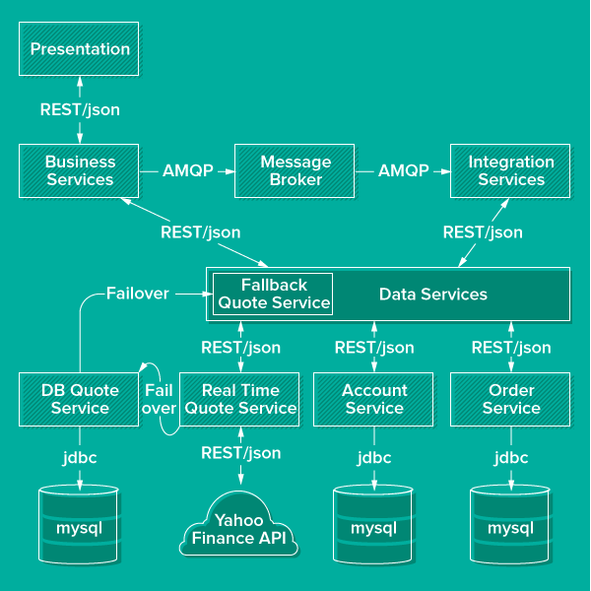

Slide 43
How to start?
Defining your domain, entities that comprise the domain and the necessary domain logic.
Service layer and only add services where the logic doesn't belong in any domain entity or value object.
Use Ubiquitous Language, Design by Contract (DbC), Automated Tests, Continuous Integration / Continuous Delivery and Refactoring
Notes:
Domain driven design effort begins where domain modeling ends. Ramnivas Laddad recommends the following steps on how to go about implementing a domain object model. He emphasizes on putting more focus on domain objects than services in the domain model.
Start with domain entities and domain logic.
Start without a service layer initially and only add services where the logic doesn't belong in any domain entity or value object.
Use Ubiquitous Language, Design by Contract (DbC), Automated Tests, CI and Refactoring to make the implementation as closely aligned as possible with the domain model.

Slide 44
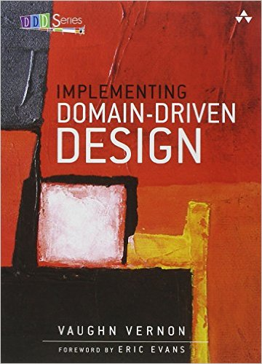
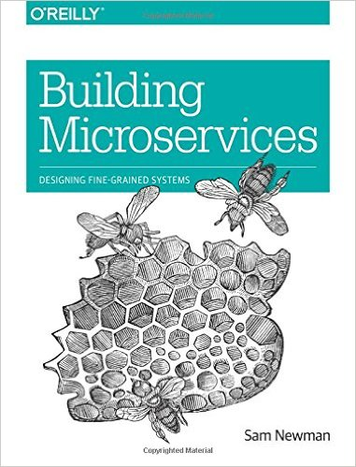
Recommended Reading

Slide 45


Break

